Slide 1


Green Pace
Security Policy Presentation
Developer: Jason Gionfriddo

Slide 2

OVERVIEW: DEFENSE IN DEPTH
Notes:
Defense in Depth has many layers, but how many is determined by the amount of time and resources can be dedicated to not only implementing the layers but also updating and maintaining those layers to ensure optimal functionality. Green Pace Secure Development Policy will focus primarily on coding and testing standards in the app security and endpoint security layers.

Slide 3
THREATS MATRIX
Likely Vulnerabilities that are easily missed | Priority These vulnerabilities are detrimental to security
Low priority These vulnerabilities are not detrimental to security | Unlikely Vulnerabilities that are easily identified or uncommon to standard practice
Notes:
Likely: vulnerabilities that are either easily missed, not explicitly checked for, or the vulnerability lies in edge cases. Priority vulnerabilities are those that present immediate risk to sensitive data or critical operating functionality. Low priority vulnerabilities are still important but do not pose immediate threats to sensitive data. These may include functions that are not optimized in terms of Big’O notation and can be resolved when immediate threats are at a minimum. Unlikely vulnerabilities are easily identified, for example logic flaws written by jr. devs.

Slide 4
10 PRINCIPLES
Validate Input Data
Heed Compiler Warnings
Architect and Design for Security Policies
Keep it Simple
Default Deny
Adhere to the Principle of Least Privilege
Sanitize Data Sent to Other Systems
Practice Defense in Depth
Use Effective Quality Assurance Techniques
Adopt a Secure Coding Standard
Notes:
The ten pricipals that are listed here are defined and talked about in further detail in the policy. For now, you should be aware that they have been hand picked to minimize threats to our data and operations.

Slide 5
CODING STANDARDS
Wraparound test implementation
Do not declare variables inside a switch statement
Do not pass a non-null-terminated character sequence to a function that expects a string
The parameters and variables should be used over raw string queries
Free dynamically allocated memory when no longer needed
Assertion use should be kept to static instances for constant expressions
Detect and handle standard library issues
Exclude user input from format strings
Keep declarations within functions compatible
Do not use concatenation to create universal character names
Notes:
The security policy also goes into these coding standards in great detail. They have been well defined with examples of acceptable practices, unacceptable practices, related policy references and tolls to help abide by these standards.

Slide 6
ENCRYPTION POLICIES
Encryption policies for:
Encryption at rest
Encryption in flight
Encryption in use
Notes:
Encryption at rest
Sensitive data such as but not limited to account numbers, card numbers, passwords, and all other information that must conform to regulatory restrictions will be hashed before storage with a minimum of 4 iterations by the hashing program. This should add a sufficient amount of protection of sensitive data in the event of a breach of system security
Encryption at flight
When data that fits requirements mentioned in the encryption at rest section will be encrypted using TLS protocol. This will help protect sensitive data as it is being transferred and may be susceptible to hacking attacks
Encryption in use
Encryption in use is the hardest to regulate and implement. The least amount of data necessary to perform business actions should be requested and viewable by those dealing with data, whether it be creating, reading, updating, or deleting data.

Slide 7
TRIPLE-A POLICIES
Authentication | Authentication is the verification that a potential user is who they claim to be. Usernames, passwords, and multifactor verification with a minimum of 2 layers should be used to authenticate users.
Authorization | Authorization is the access that is to be granted to an authenticated system user. There will be at the minimum departmental separation of concerns, and the principal of the least amount of privilege given to complete business tasks will be strictly adhered to.
Accounting | Accounting will log system transactions for review at a later date. These reviews will be performed by multiple authorized and qualified personnel with the intent of reporting to the adherence of security protocol and effectiveness of said protocols.

Slide 8
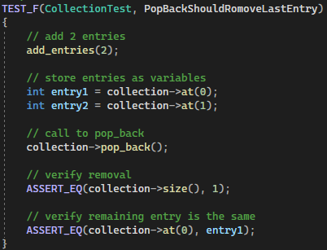
Popback should remove the last entry

Slide 9
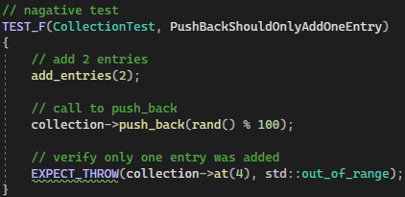
Pushback should only add one entry

Slide 10
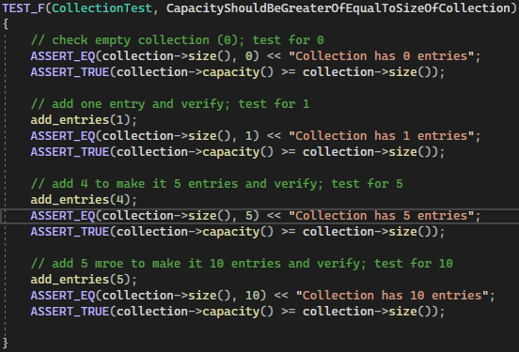
Capacity should be greater or equal to size of collection

Slide 11
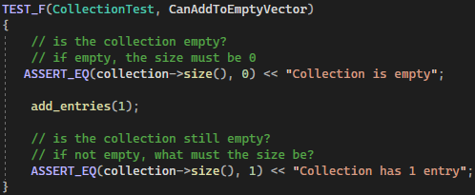
Can add to an empty vector

Slide 12
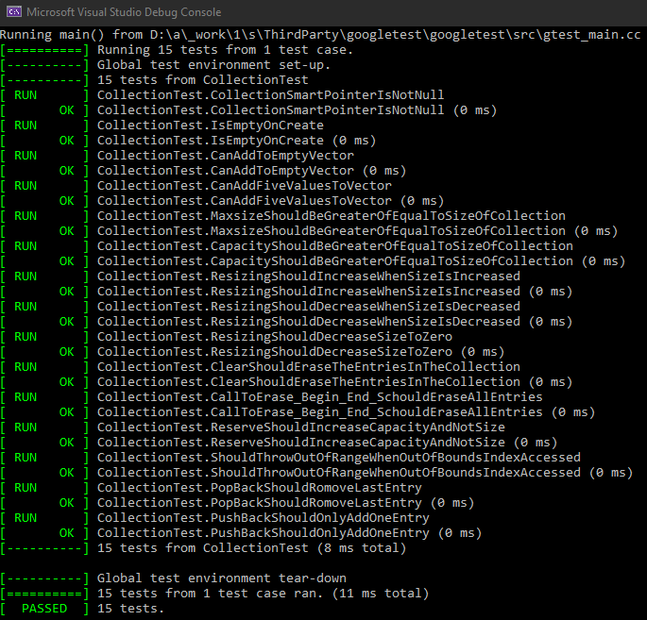
Test Suite example output

Slide 13

AUTOMATION SUMMARY

Slide 14
TOOLS
Compass/Rose
CodeSonar
Polyspace Bug Finder
Parasoft C/C++ test
PC-line Plus
Notes:
DevSecOps incorporates a security first mindset into SDLC as opposed to typical devops where infosec often comes at the end. DevSecOps take Continuous Integration/Continuous Deployment and includes security checks at every phase. The phases include Plan, Code, Test, Release, and deploy. In the planning phase, the how, where, and whens of testing will be determined. These tools will start to come into effect for the code, build, test, and release phases.

Slide 15
RISKS AND BENEFITS
Risks:
Security breaches
Vulnerabilities discovered last minute
Loss of millions in lawsuits
Benefits:
Prevent consumer data leaks
Catch vulnerabilities early
Notes:
Ashley Madison example. Security measures can be added to the CI/CD pipeline, as discussed above. Each time a developer builds a code, he runs a CI/CD pipeline tool that does all the necessary processes, i.e., pushing code to a shared repository and sending notifications to other team members.

Slide 16
RECOMMENDATIONS
Adopt DevSecOps principals to:
Plan
Code
Build
Test
Release
Deploy
Notes:
Plan In the planning phase, execute security analysis and create a plan to determine scenarios for how, where, and when testing will be done.
Code Deploy and use linting tools and Git controls to secure passwords and API Keys.
Build Use of Static application testing (SAST) tools to track down flaws in code before deploying it on production. These tools are specific to programming languages.
Test While testing your application, The dynamic application security testing (DAST) tools are used to detect errors associated with user authentication, authorization, SQL injection, and API-related endpoints.
Release The security analysis tools are used to perform vulnerability scanning and penetration testing. These tools should be used just before releasing the application.
Deploy After completing the above test in runtime, send a secure infra or build to production for final deployment.

Slide 17
CONCLUSIONS
Stick to the identified tools
Follow the coding standards
Be diligent in the policies principals

Slide 18
REFERENCES
Carnegie Mellon University. (2020). SEI CERT C++ Coding Standard. Retrieved from Carnegie Mellon University : https://wiki.sei.cmu.edu/confluence/pages/viewpage.action?pageId=88046682
Xenonstack.com(2022) DevSecOps Pipeline - A Complete Overview
https://www.xenonstack.com/insights/guide-devsecops-pipeline
Cprogramming.com. (2019). XOR Encryption in C++. Retrieved from Cprogramming.com: https://www.cprogramming.com/tutorial/xor.html

